Slide 1




OUR
SOHIL
GROUP
VIVEK
MEMBERS
RUCHIR

Slide 2



SMART WATER SUPPLIER
OUR
TOPIC

Slide 3

NEED
AND
WATER CRISIS
SCOPE
NO NOTIFIER
NO PLATFORM

Slide 4

MODULES
CRISIS MARKING
ONLINE BOOKING
FAQ & POLICIES
USER REGISTRATION
SUPPLIER DETAILS
NEWS SECTION
EDIT USER PROFILE
ORDER COMPLAINT
ABOUT US & CONTACT US
APP FEEDBACK & RATING

Slide 5

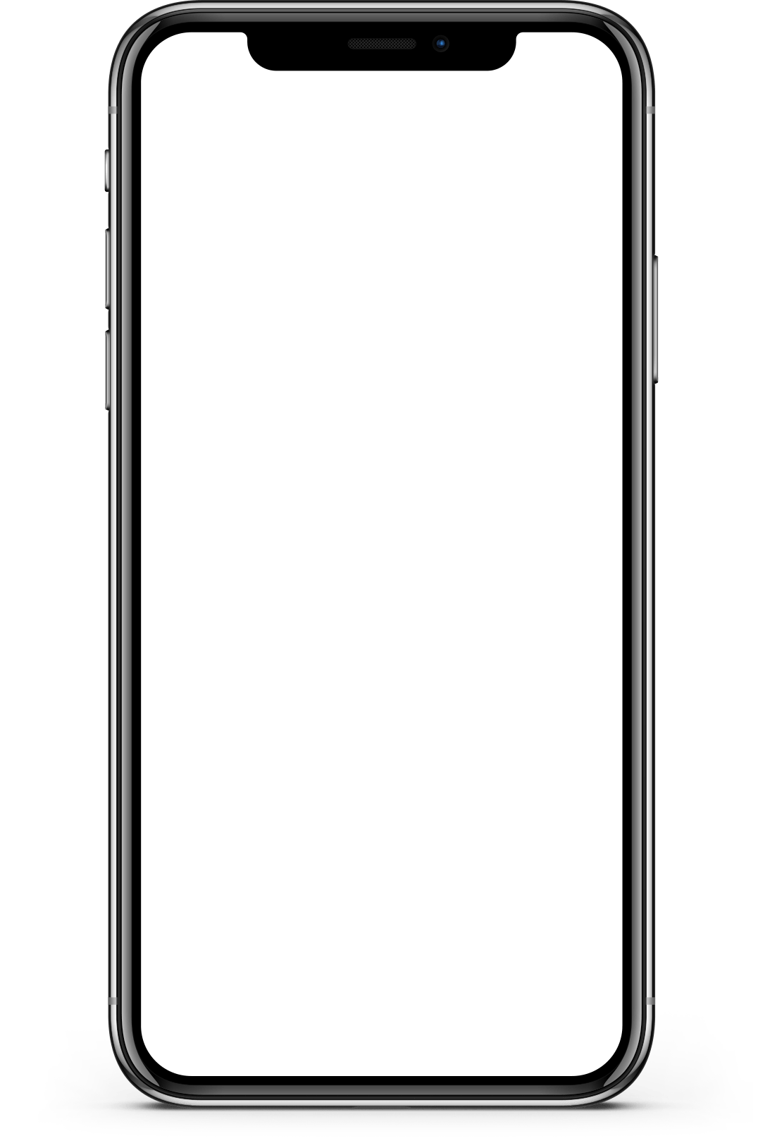





REQUIREMENTS

Slide 6
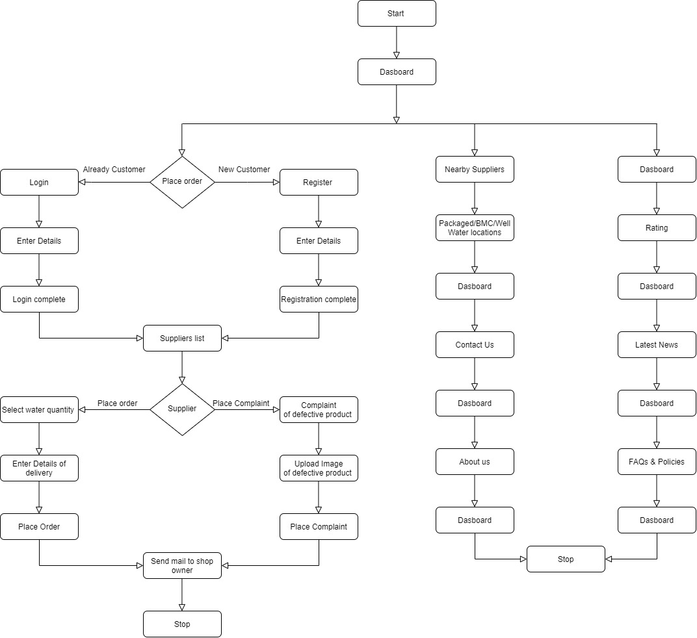
Flow Diagram

Slide 7

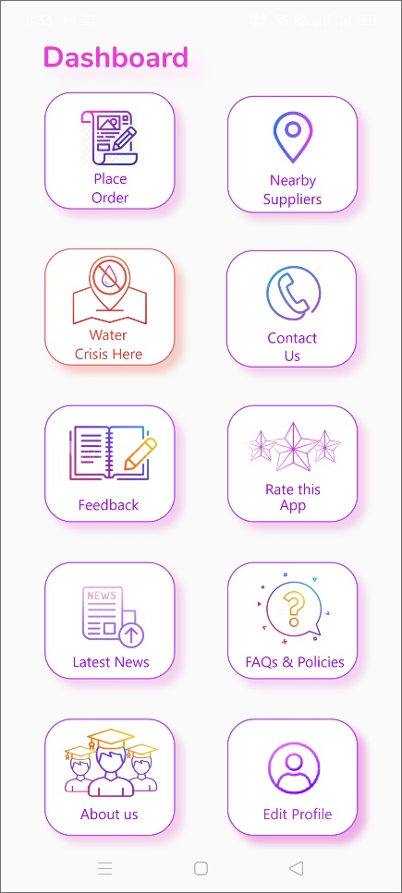
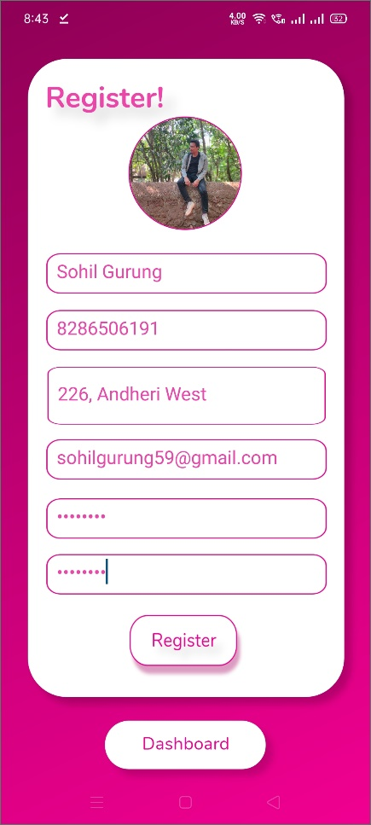
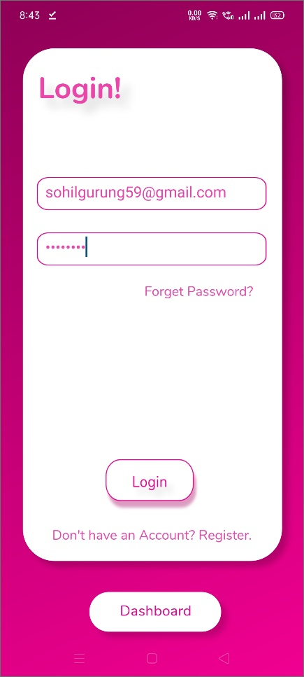
Screenshots of Version 1.0

Slide 8
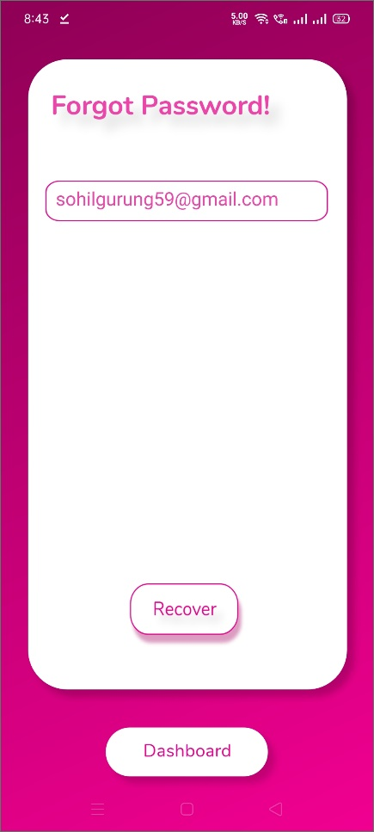
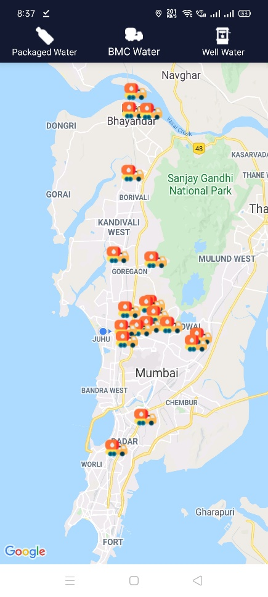
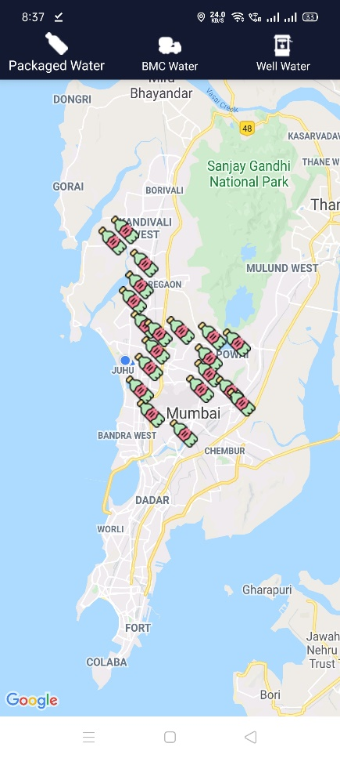
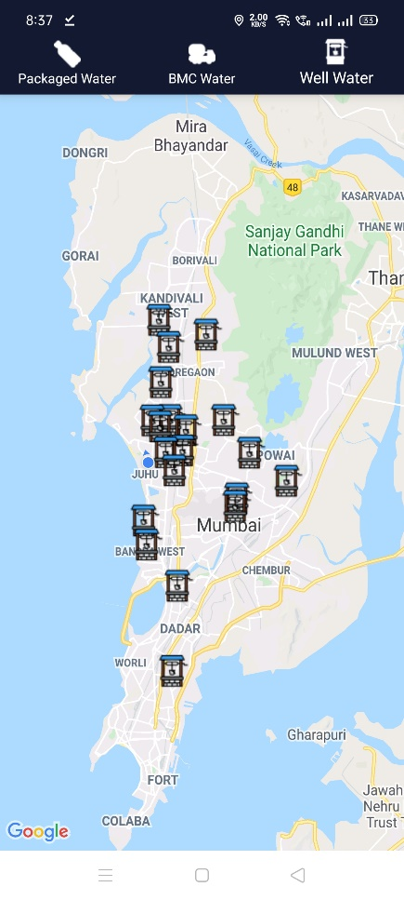
Screenshots of Version 1.0

Slide 9
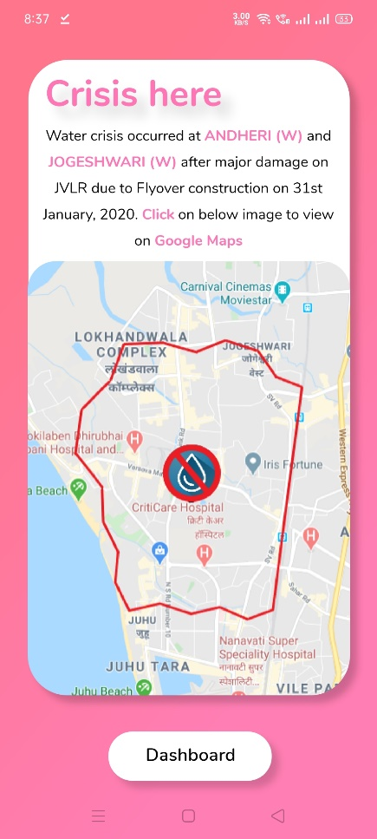
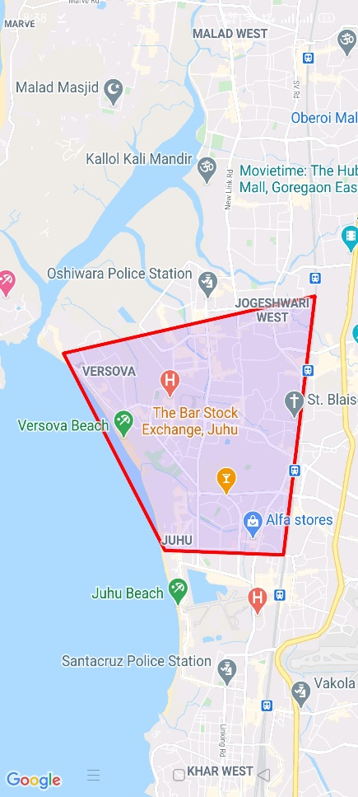
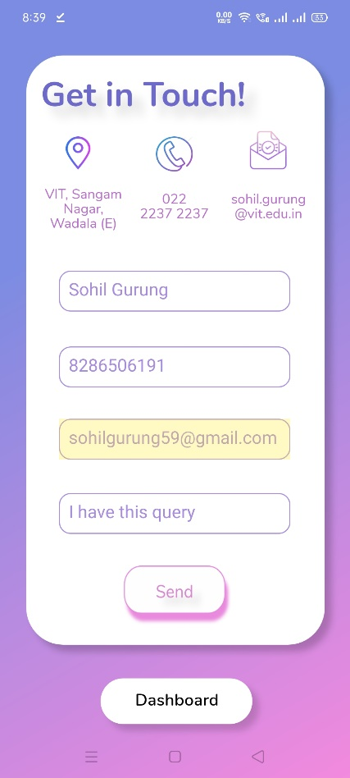
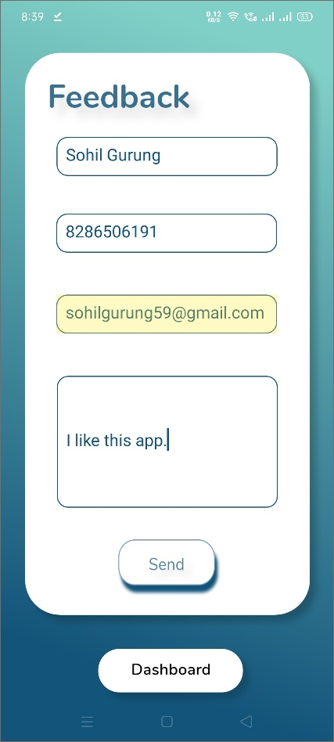
Screenshots of Version 1.0 1.0

Slide 10
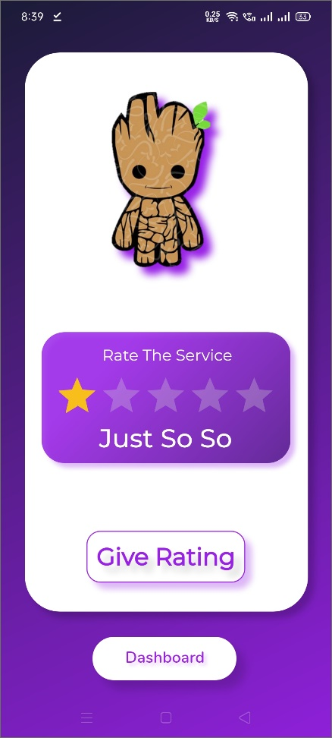
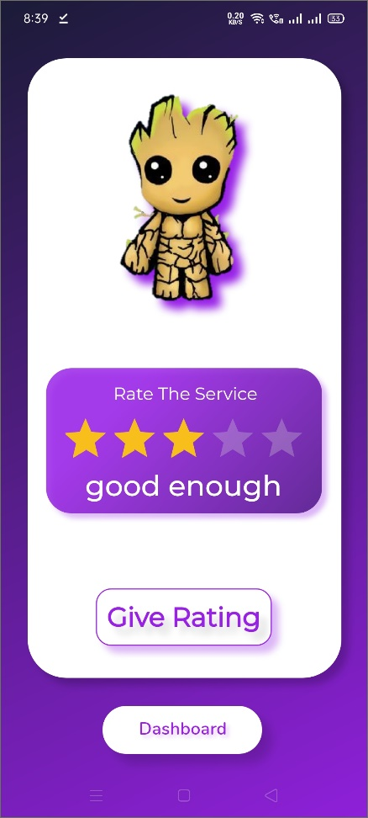
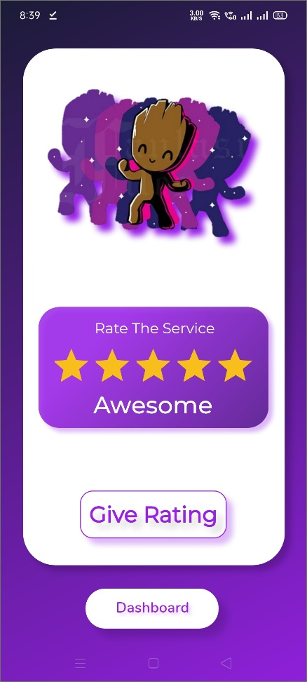
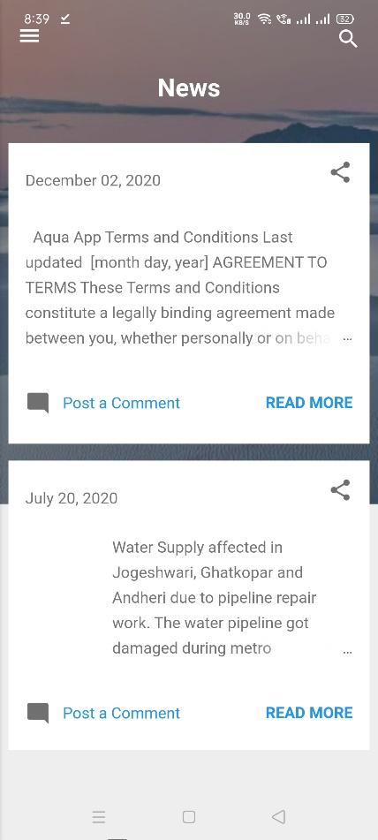
Screenshots of Version 1.0

Slide 11
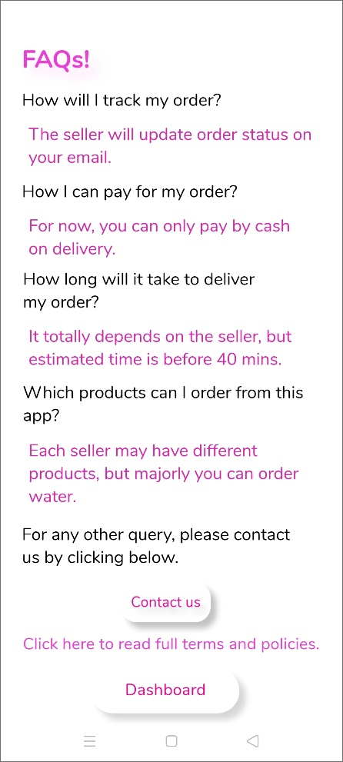
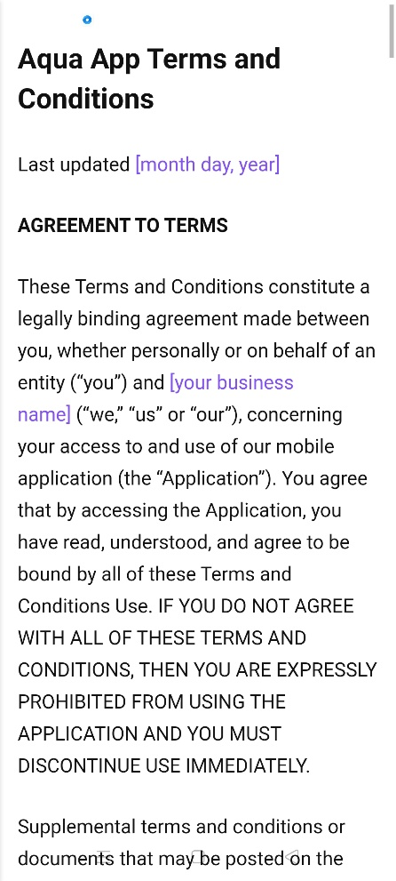
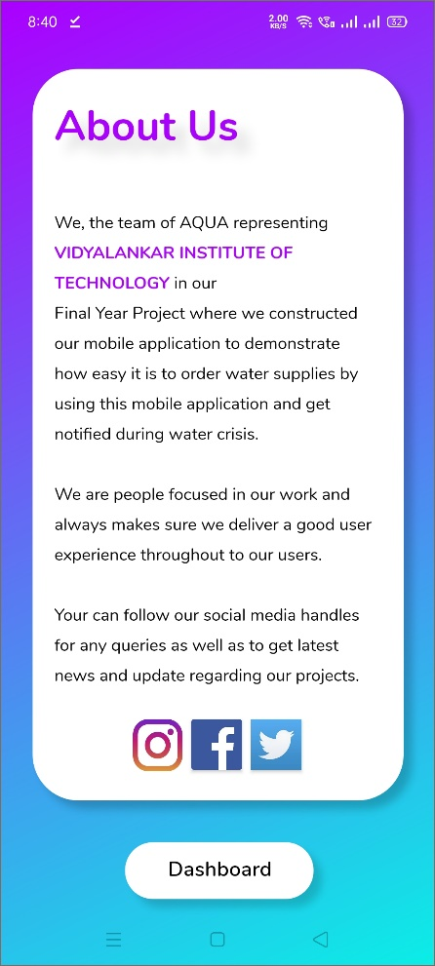
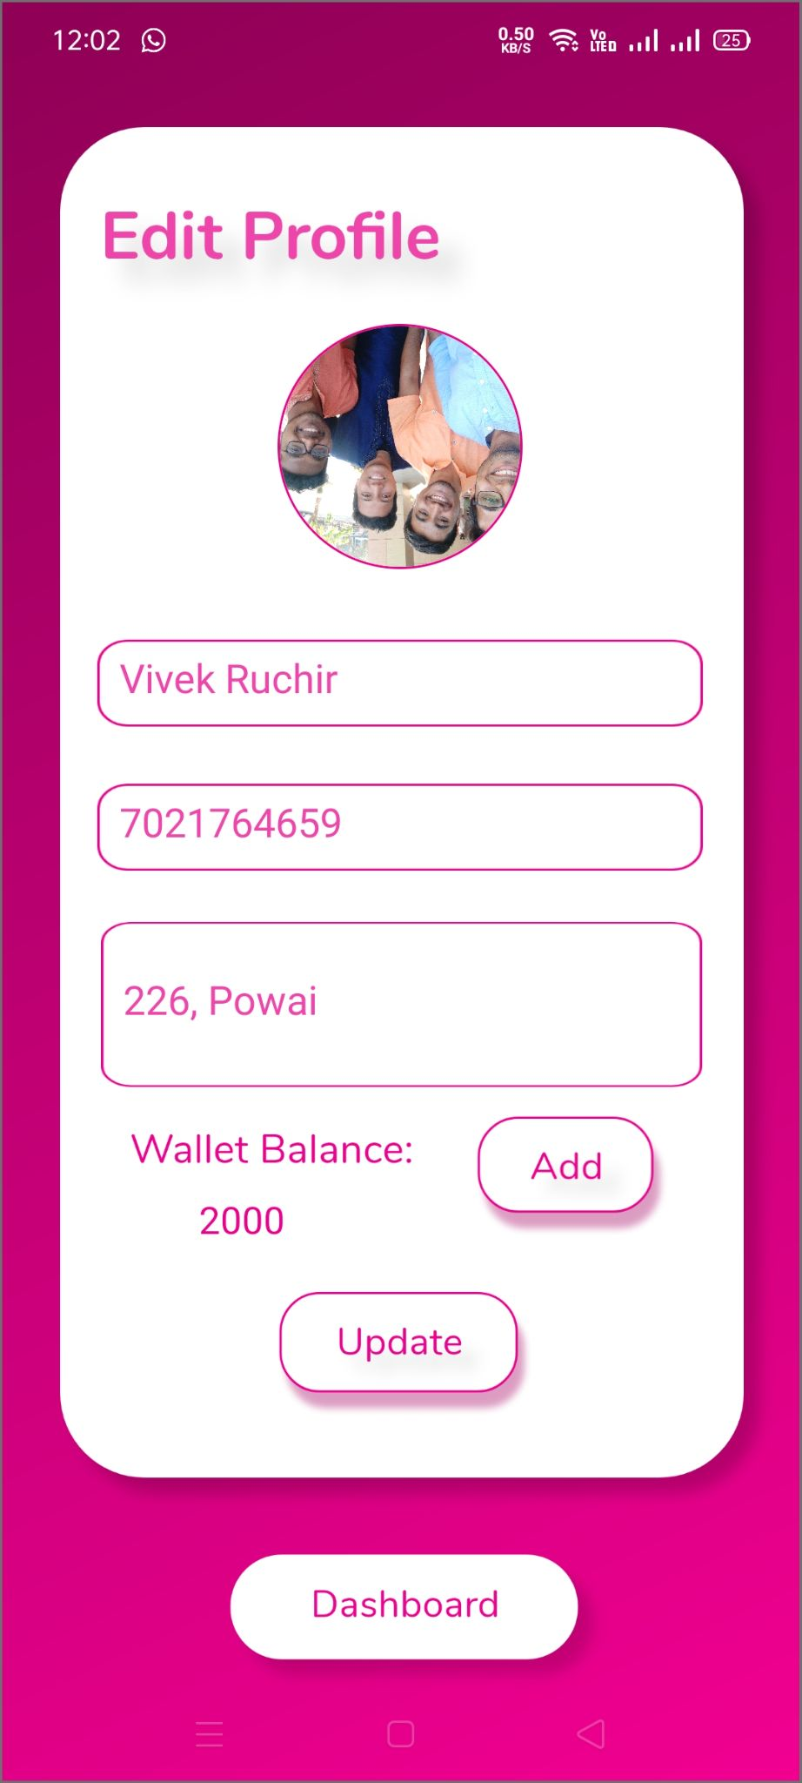
Screenshots of Version 1.0

Slide 12
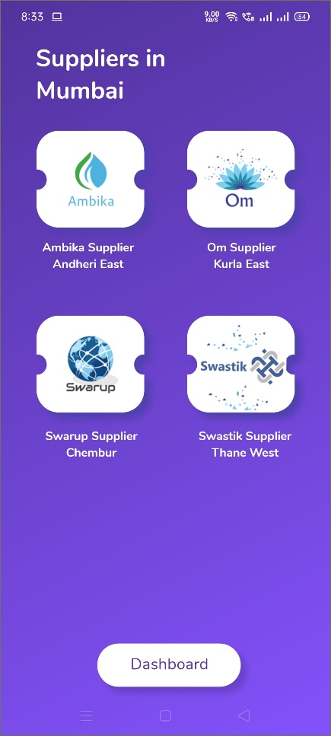
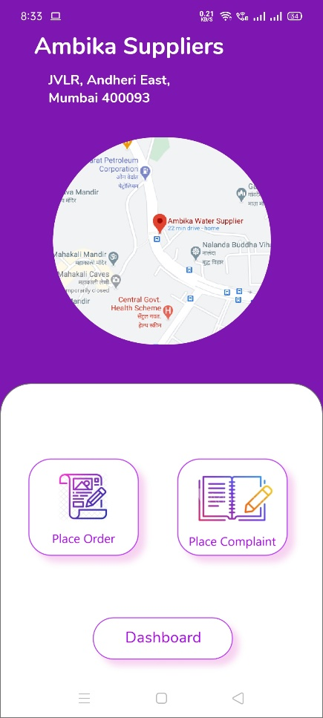
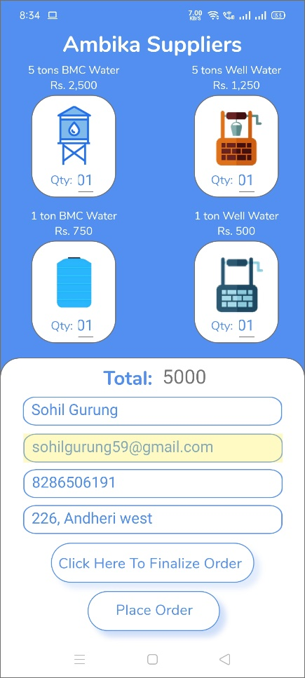
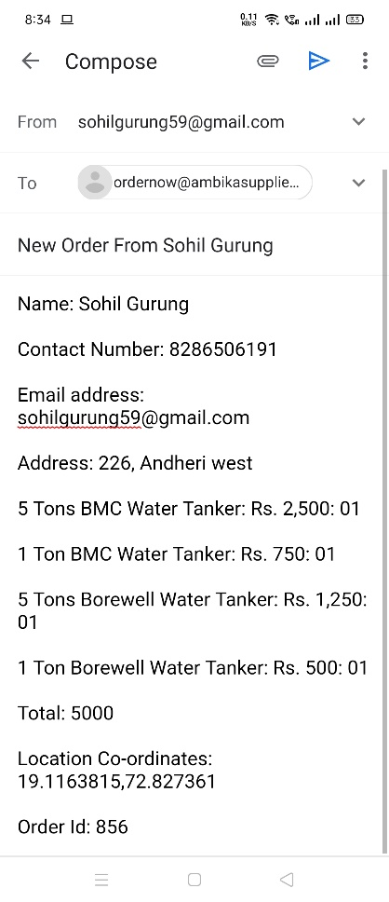
Screenshots of Version 1.0

Slide 13
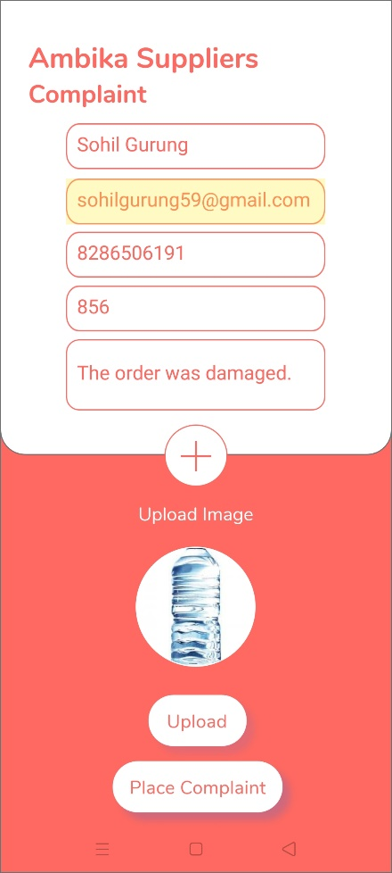
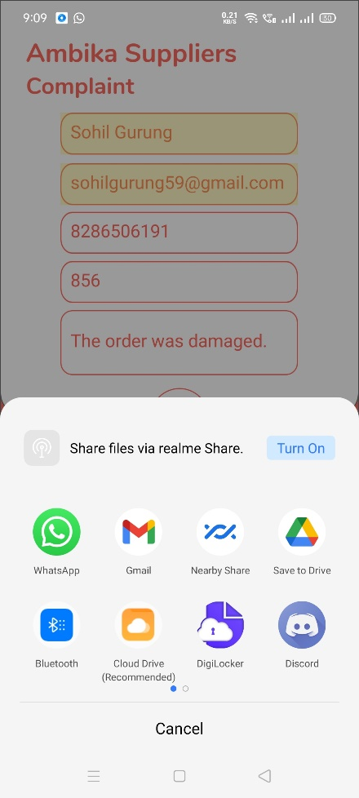
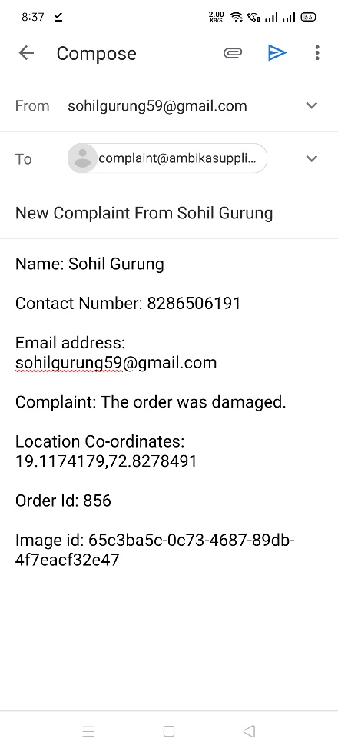
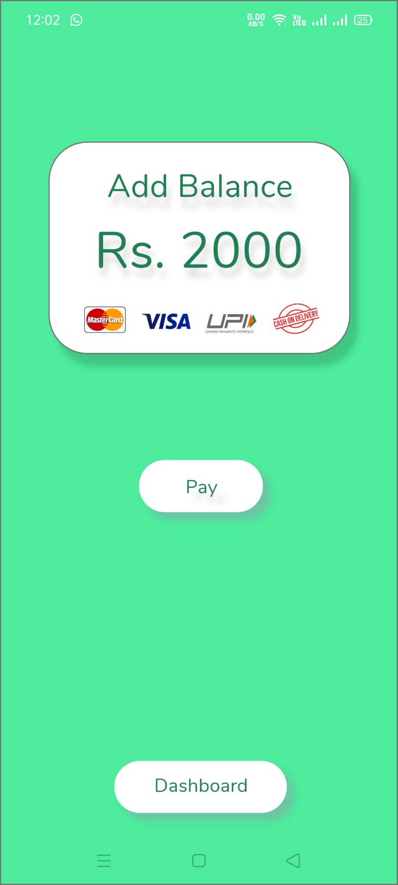
Screenshots of Version 1.0

Slide 14
REFERENCE
Documentation on Android app development by Google.
Java tutorials by Tutorials point.
Android tutorials by Tutorials point.
Error Solutions from Stackoverflow.
Professional Android 4 Application Development.
Beginning Android Application Development.

Slide 15
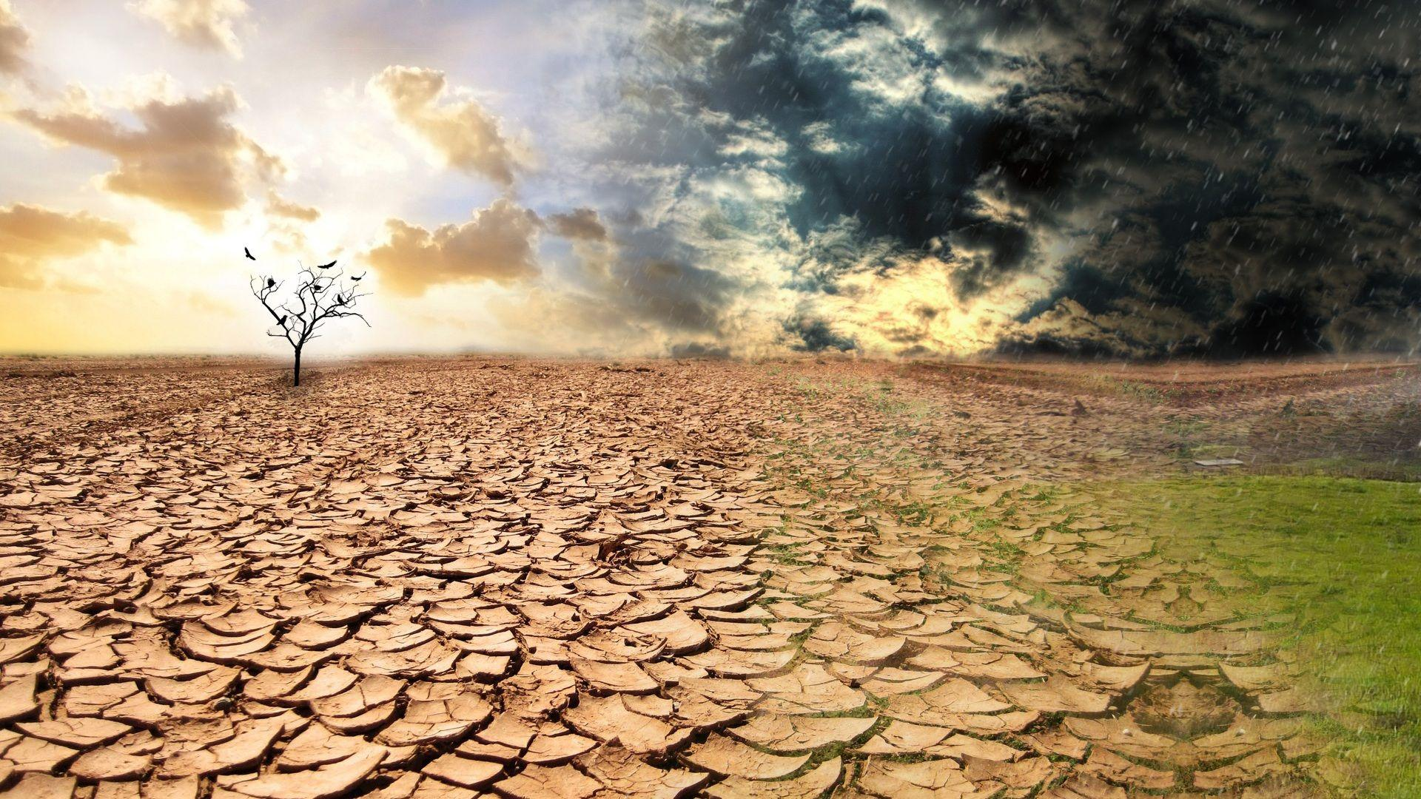
THANK YOU
SAVE WATER

